Slide 1
ICU Patient Survival Prediction
Presented By:
Subramanian Arumugam
Abinesh Ganesan
Drona Charyulu Ronanki
Shraddha Joshi
Tasleem Syed
MSA – 8010 Data Programming
November 30, 2022

Slide 2
AGENDA
Problem Statement & Motivation
Data Description
EDA (Exploratory Data Analysis)
Data Cleaning & Feature Engineering
Modeling using ML & AI
Key Takeaway and insights

Slide 3
Problem Statement
To predict the survival rate of ICU patients based on their vital and medical history.
Data Source
The data is originally from Kaggle:
Mitisha Agarwal. (2021). <i>Patient Survival Prediction</i> [Data set]. Kaggle.
https://doi.org/10.34740/KAGGLE/DSV/2972359

Slide 4
Motivation
ICU departments typically treat patients with severe illness who need constant care and supervision.
It becomes hard for ICUs to focus attention on all patients when they are at full capacity.
If the DS model could predict which patients are less likely to survive, then the department can allocate more resources to these patients.

Slide 5
Dataset Info

Slide 6
Dataset
There are 80 features and 91713 records of data.
This is an imbalanced dataset where the target variable under consideration is just 8.6% of the total records.
This dataset contains the health conditions of ICU patients during their ICU admission.
The target variable is the Hospital Death Column which states if a patient Survived (0) or Passed Away (1) during their treatment.
There are 25 Categorical features and 55 numerical features
Notes:
health conditions: blood test results, previous disease info, age and gender

Slide 7
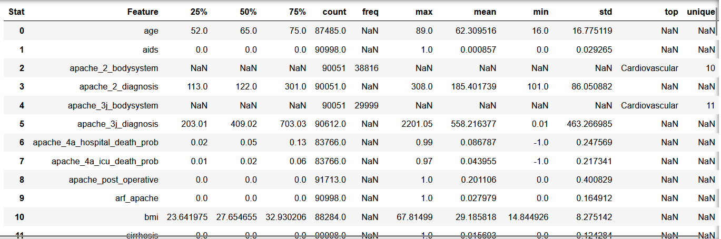
Data Stats

Slide 8
EDA

Slide 9
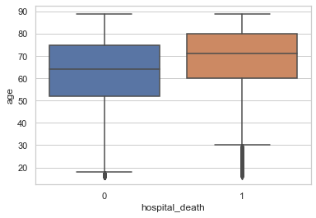
Age Distribution and Hospital Death
The mean age of those we pass away during ICU admission is 68.5 compared to those who survive at 61.7.

Slide 10
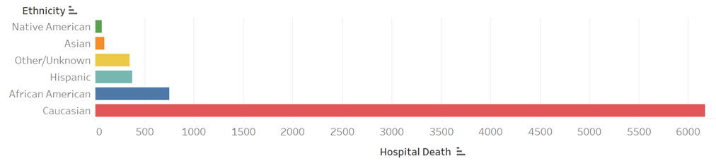
Ethnicity and Hospital Death
We can infer that in this dataset, the Caucasian ethnic group have suffered the most losses.

Slide 11
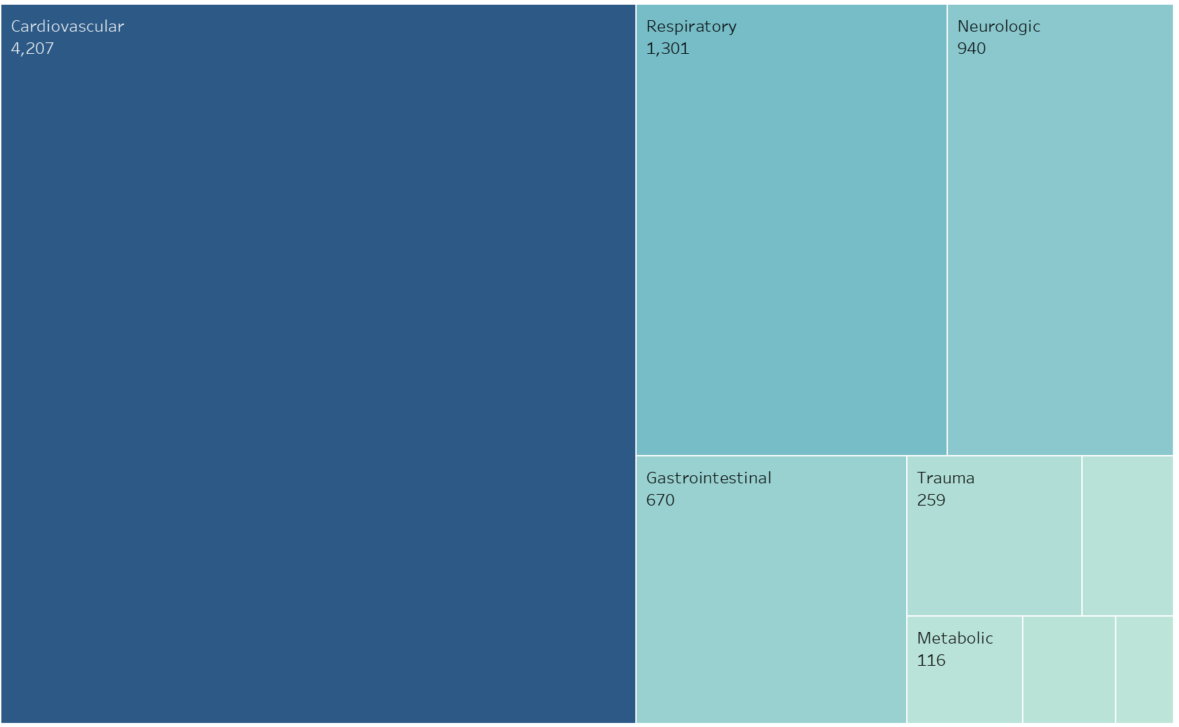
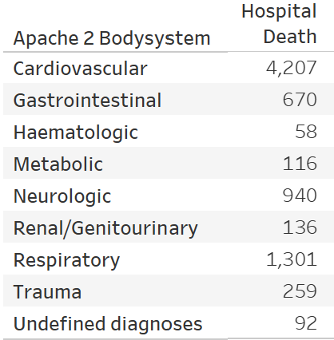
Reasons for Hospital Death

Slide 12
Data Cleaning

Slide 13
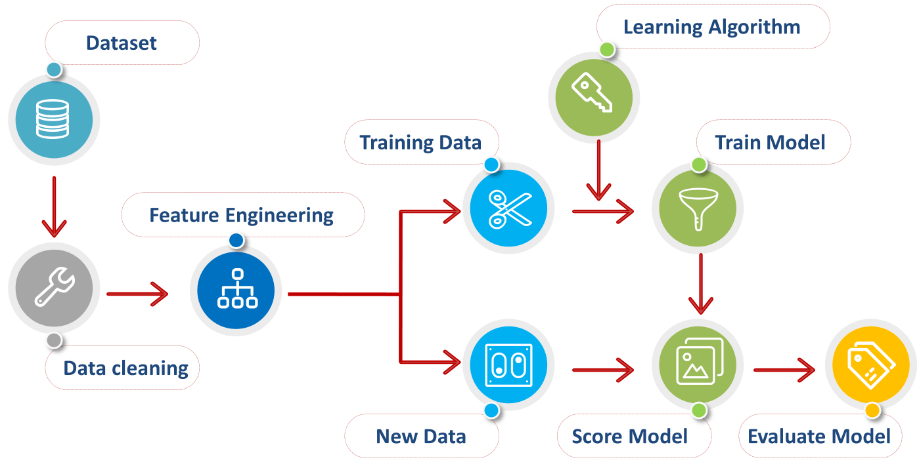
Approach Using ML Pipeline

Slide 14
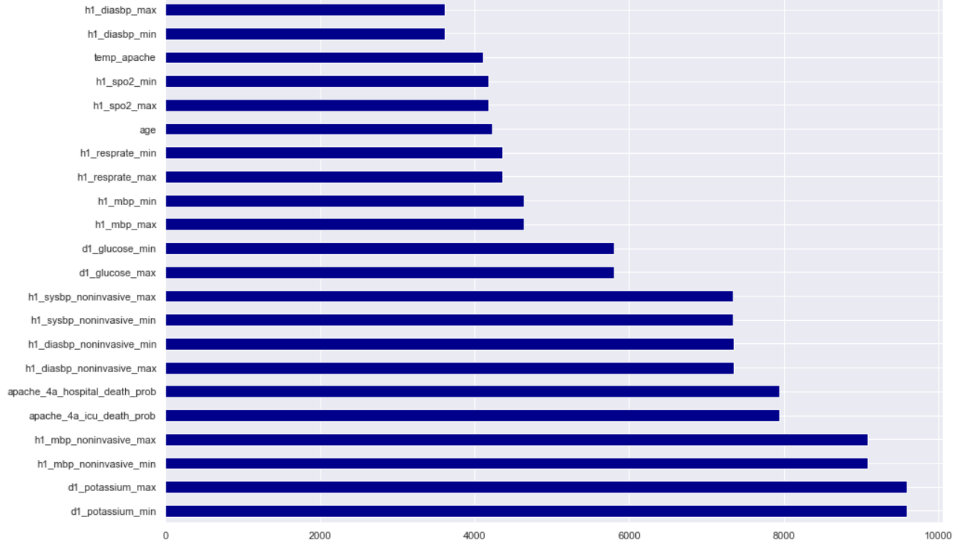
Treating Missing Values
The missing values in the categorical columns were imputed with a “NA” string
This NA string will be interpreted as another category.

Slide 15
Outlier Handling and Scale Normalization
COLUMN | BINS | LABELS
apache_2_diagnosis | [101.000000, 142.400000, 266.600000, 308.000000] | ['low','medium','high']
apache_3j_diagnosis | [0.010000, 440.218000, 880.426000, 1320.634000, 2201.050000] | ['low','medium','high','very_high']
apache_4a_hospital_death_prob | [-1.000000, -0.204000, 0.194000, 0.592000, 0.990000] | ['low','medium','high','very_high']
apache_4a_icu_death_prob | [-1.000000, -0.212000, 0.182000, 0.576000] | ['low','medium','high']
bmi | [14.844926, 25.438939, 36.032951, 46.626964, 67.814990] | ['low','medium','high','very_high']
d1_diasbp_max | [46.000000, 69.800000, 93.600000, 117.400000, 165.000000] | ['low','medium','high','very_high']
d1_diasbp_min | 13.000000, 32.250000, 51.500000, 70.750000, 90.000000 | ['low','medium','high','very_high']
d1_diasbp_noninvasive_max | [46.000000, 75.750000, 105.500000, 165.000000] | ['low','medium','high']
d1_diasbp_noninvasive_min | [13.000000, 32.250000, 51.500000, 70.750000, 90.000000] | ['low','medium','high','very_high']
d1_glucose_max | [73.000000, 149.857143, 226.714286, 303.571429, 380.428571, 611.000000] | ['very_low,'low','medium','high','very_high']
d1_glucose_min | [33.000000, 75.500000, 118.000000, 160.500000, 288.000000] | ['low','medium','high','very_high']
Each Team Member worked on creating custom bins for each numeric column by analyzing the distribution of the numeric column.

Slide 16
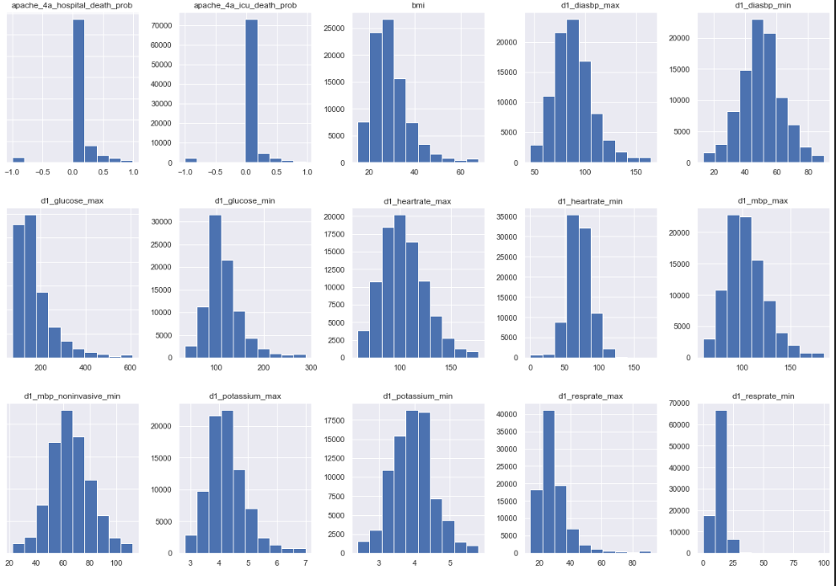
Feature Engineering
Each of the 55 numeric features had different scales and distributions
These numeric columns also contain outliers
Analyzed the histogram of all numeric columns to create bins.

Slide 17
Scaling Columns & Label Encoding

Slide 18
Modelling
Notes:
Sri

Slide 19
Sampling
The target value of interest: Hospital Death is a minor sample in this dataset with only 8.6% records.
We decided to have an equal distribution of records from both target classes.
The majority class was then under-sampled to contain 8.6% records.

Slide 20
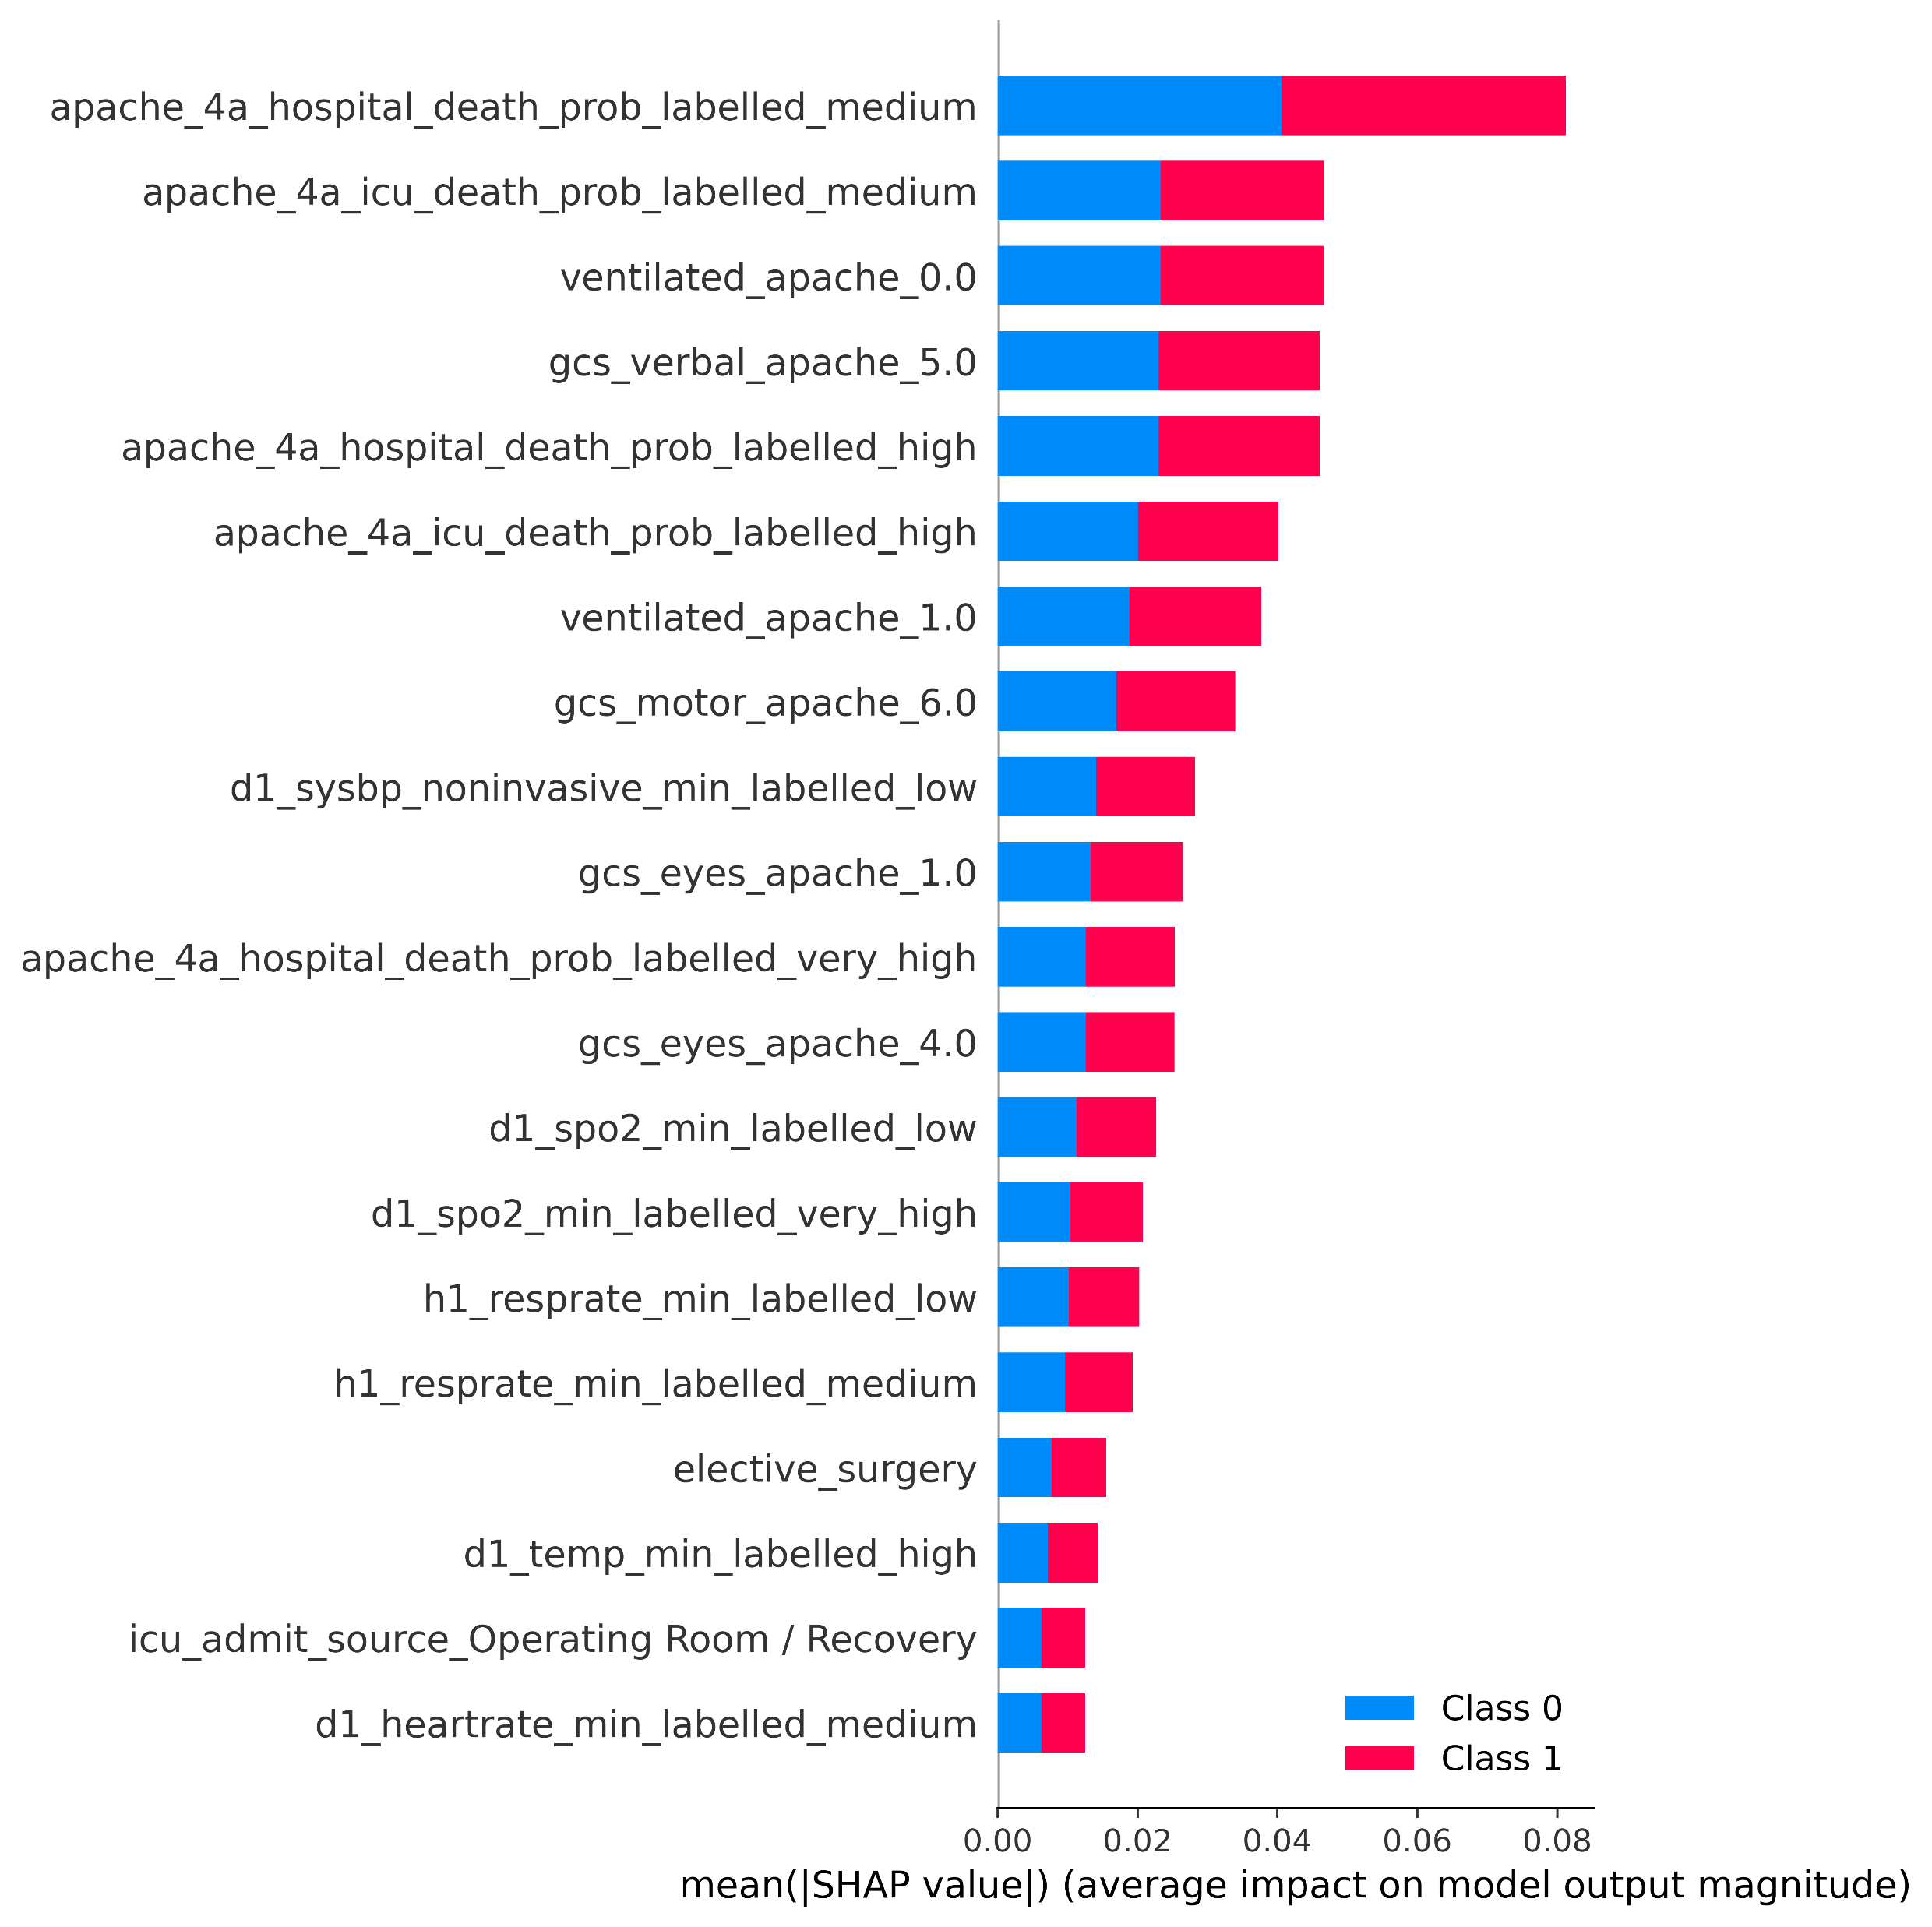
Dimensionality Reduction and Random Forest
SHAP Values Identifying Feature Importance
After Feature Engineering, we have 80 Categorical Columns.
Performing One Hot Encoding on these columns increased the column count to 308.
We then used Random Forest Model to predict the Target Variable using the 308 independent columns.
We utilized the RF variable importance score to pick the essential features and used these features to train other models.

Slide 21
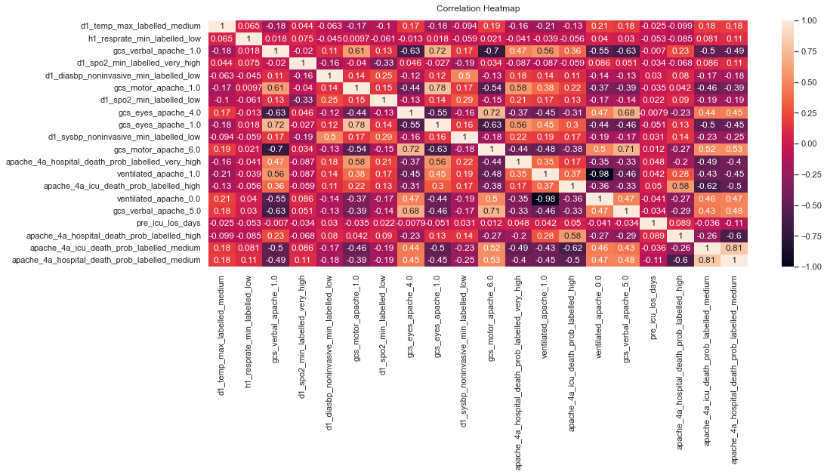
Correlation Heat Map on Training Data

Slide 22
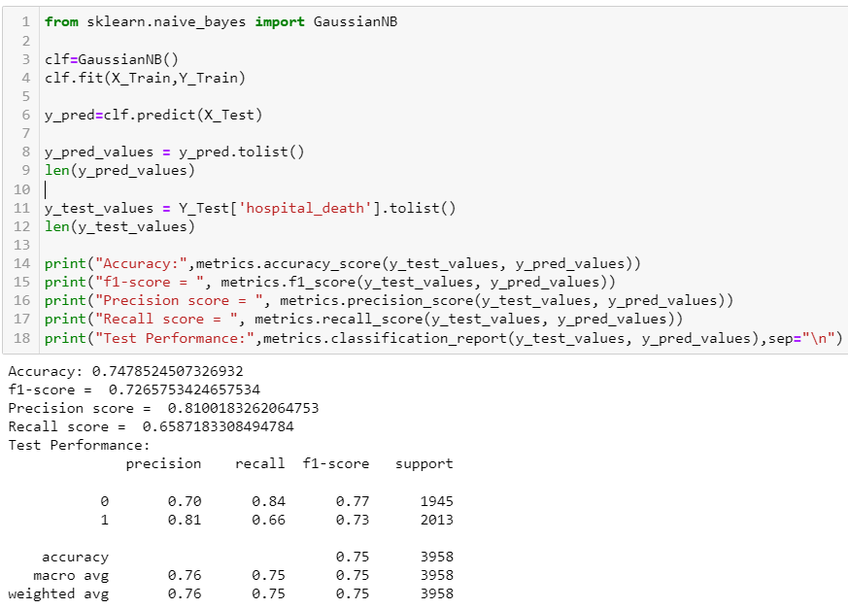
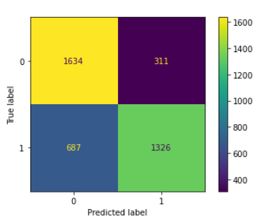
Naïve Bayes
f1-score = 73
Precision score = 81
Recall score = 66
Accuracy = 75
Notes:
Naives Bayes is based out of Bayes Theorem. We thought this model will be helpful as we have a lot of categorical columns.
We trained this model and got 66% recall.

Slide 23
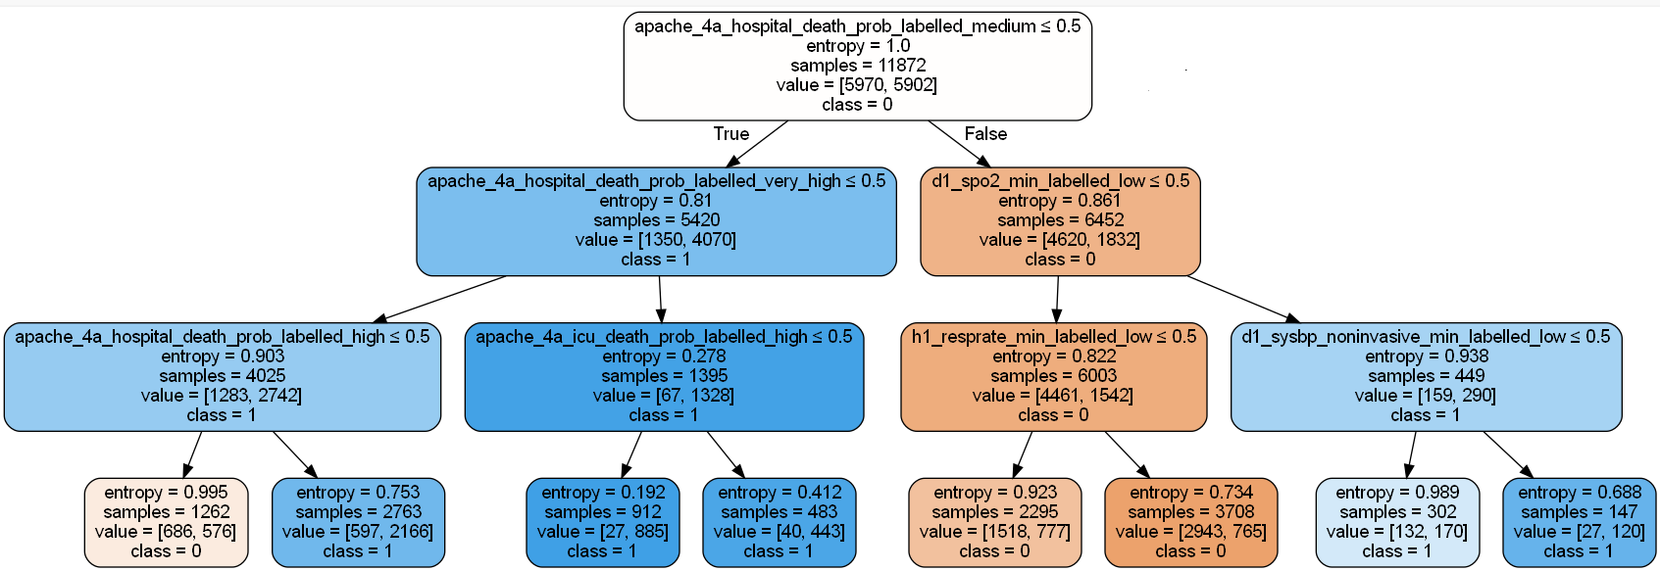
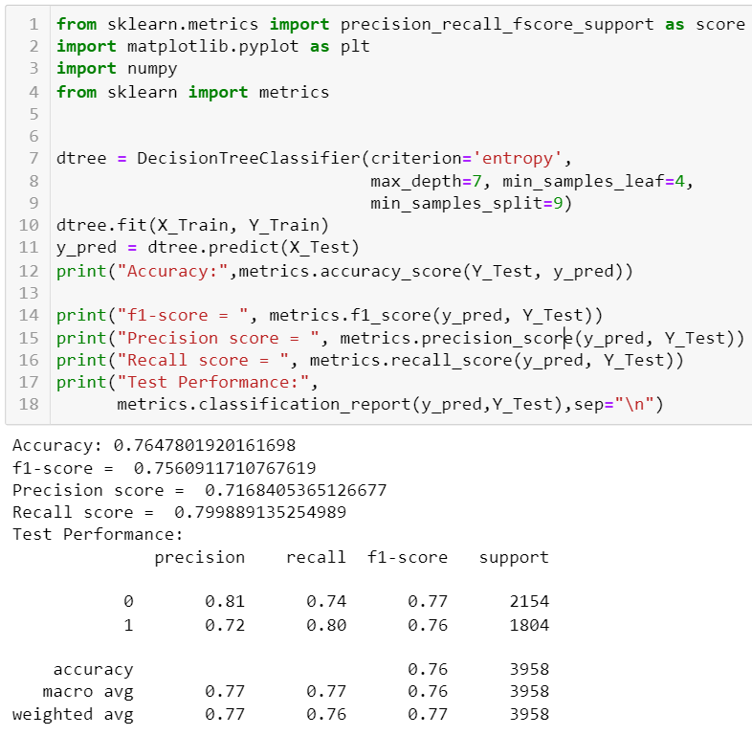
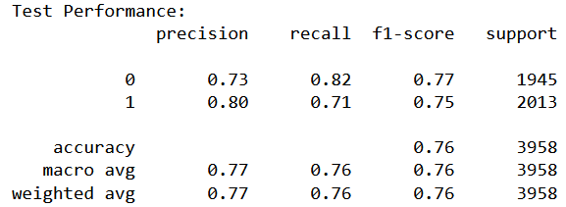
Decision Trees
Recall: 76.0, Precision: 77.7, F1 Score: 77.7, Accuracy: 76.47
Notes:
Charanya

Slide 24
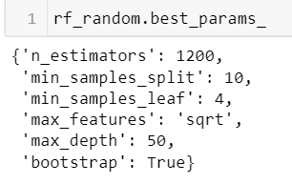
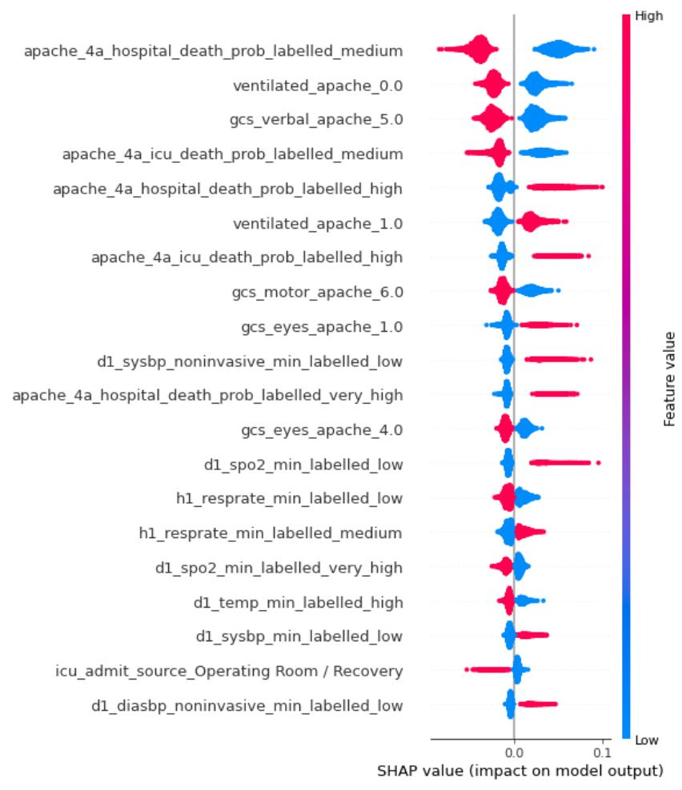
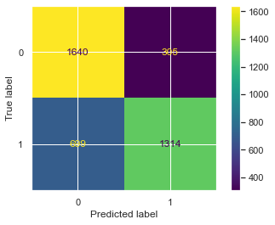
Random Forest
SHAP Values - Feature Impact on Model output
F1-score = 78.09
Precision score = 80.63
Recall score = 75.7
Accuracy = 78.39

Slide 25
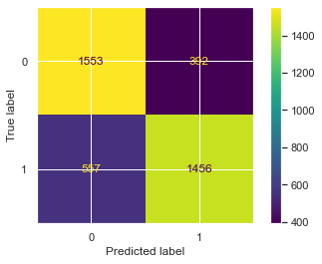
XGBoost
Confusion Matrix
f1-score = 0.75
Precision score = 0.79
Recall score = 0.72
Accuracy = 0.76

Slide 26
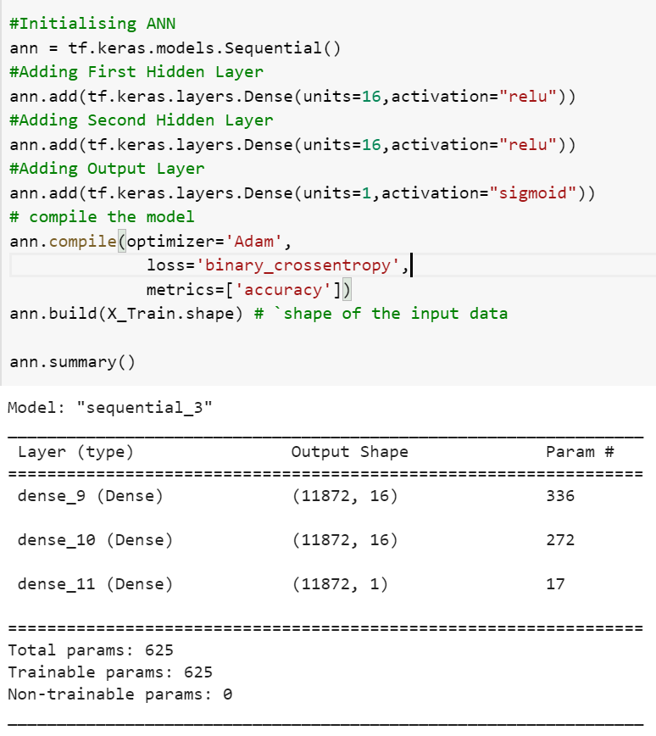
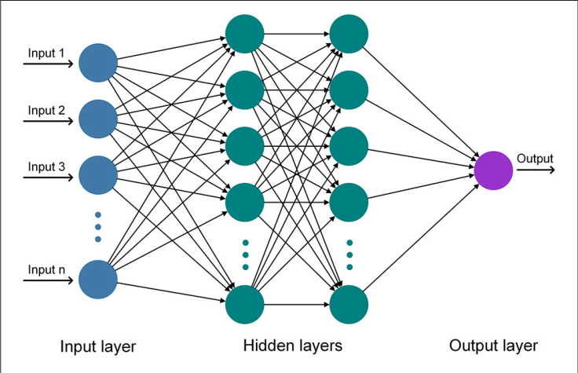
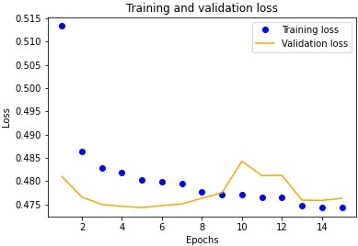
ANN (Artificial Neural Network)
Accuracy = 0.77
f1-score = 0.782
Precision score = 0.78
Recall score = 0.77

Slide 27
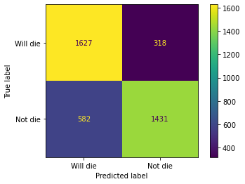
Support Vector Machine (SVM)
Confusion Matrix
Main Parameters are C, Kernel(RBF) and Gamma
F1-score: 0.7607
Precision score: 0.7108
Recall score: 0.8181
Accuracy: 0.7726

Slide 28
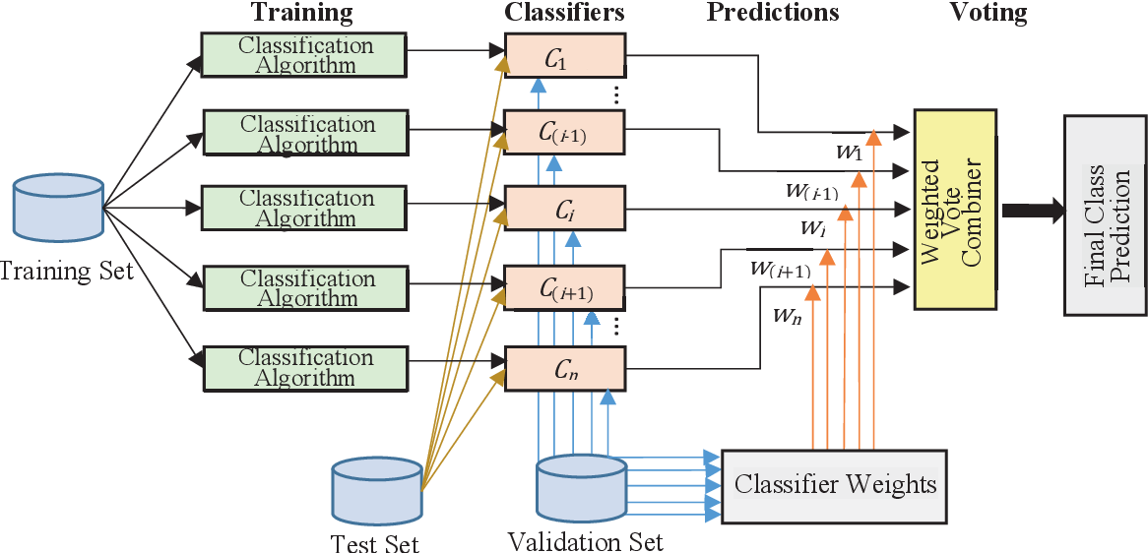
Voting Classifier
Recall: 71.0
Precision: 80
F1 Score: 76
Accuracy: 77

Slide 29
Model Analysis
Model | Accuracy | Precision | Recall | F1 - Score
Decision Tree | 75.7 | 78.9 | 72.9 | 75.8
Random Forest | 78.3 | 80.6 | 75.7 | 78.1
XG Boost | 76 | 79 | 72 | 75
ANN | 76 | 79 | 74 | 76
SVM | 76 | 72 | 80.4 | 75.6
Voting Classifier | 77 | 80 | 71 | 76

Slide 30
Key Takeaways
We can infer that the ML models we trained are able to learn the patterns and differentiate between the target feature values.
On an average, all models provided a Recall score of above 70%.
Given more training data, we will be scale up this solution and create a robust solution.
We can see that the features collected per patient is able to explain the variance in the dataset.
The features offer a snapshot of the patient’s health condition during ICU admission. It would be more helpful to have access to the patient’s daily health status/vitals.

Slide 31
Questions

Slide 32
Thank You!

